Slide 1



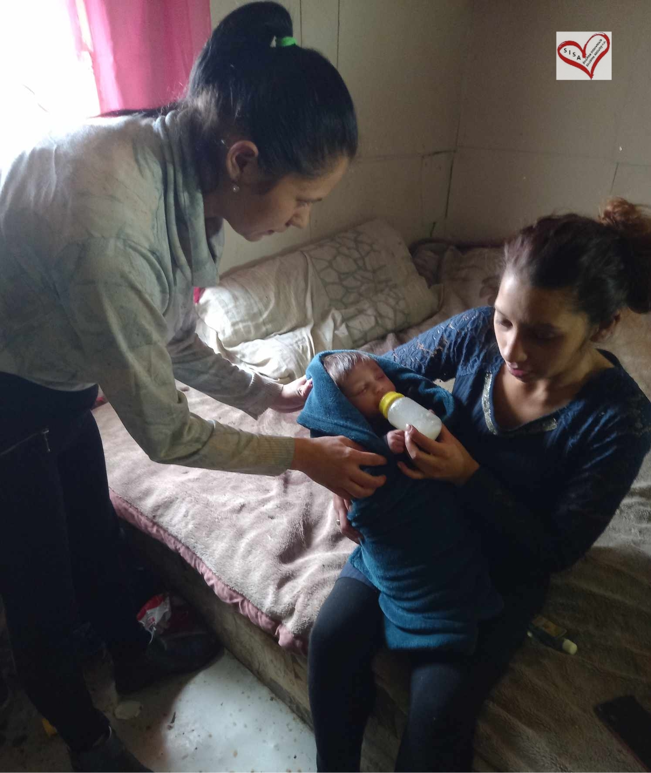
PROFI MAMY PRaktické Overovanie Foriem Inovatívneho poskytovania služieb ranej starostlivosti v marginalizovaných rómskych komunitách prostredníctvom asistentiek raného vzdelávania v MRK
Bratislava, 6. november 2025
Project PROFI MAMY, project code 06R01-20-V01-00134 is financed by the European Union NextGenerationEU
www.planobnovy.sk www.minedu.sk www.sisa.home.sk
Notes:
PROFI MOTHERS – PRactical Observation of Forms of Innovative Provision of Early Childhood Care Services in Marginalized Roma Communities through Early Education Assistants in MRC

Slide 2
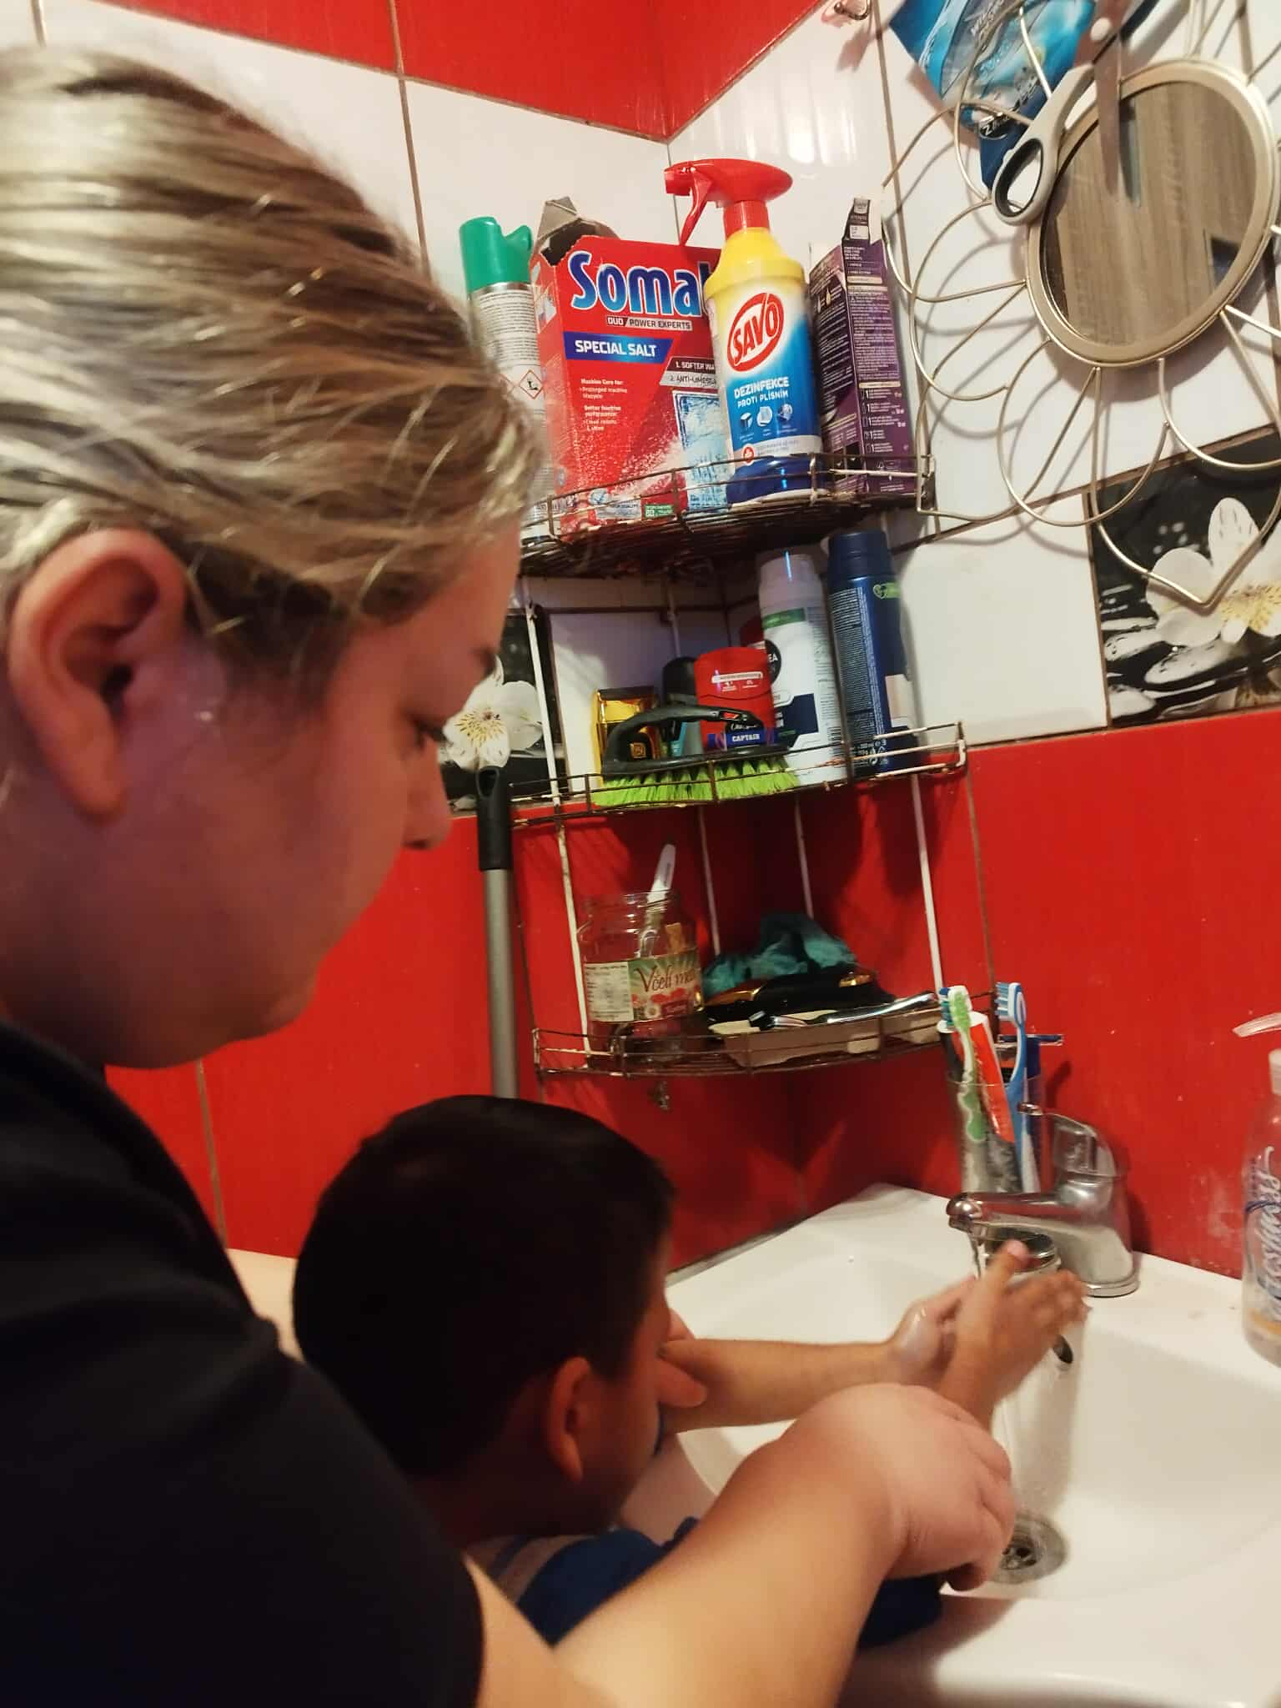

Project Title: PROFI MAMY - PRaktické Overovanie Foriem Inovatívneho poskytovania služieb ranej starostlivosti v marginalizovaných rómskych komunitách prostredníctvom asistentiek raného vzdelávania v MRK Project Title: PROFI MOTHERS Project Code: 06R01-20-V01-00134 Call Title: Support for the provision of early care and early intervention for children aged 0 to 6 years from marginalized Roma communities and from environments of generational poverty. Call Code: 06R01-20-V01 Reform Title: Reform 1: Ensuring conditions for the implementation of compulsory pre-primary education for children from 5 years of age and the introduction of a legal entitlement to a place in a kindergarten or with other providers of pre-primary education from 3 years of age. Component Title: Component 6: Availability, development, and quality of inclusive education at all levels. Project Duration: February 2024 – January 2026 Project Implementation Location: Bačkovík, Blatné Remety, Kecerovce Beneficiary: SISA – sociálna intervencia, sociálne aktivity n.o. Director: Silvia Hricková
Project PROFI MAMY, project code 06R01-20-V01-00134 is financed by the European Union NextGenerationEU
www.planobnovy.sk www.minedu.sk www.sisa.home.sk
Notes:
Non-profit organization SISA - social intervention, social activities

Slide 3
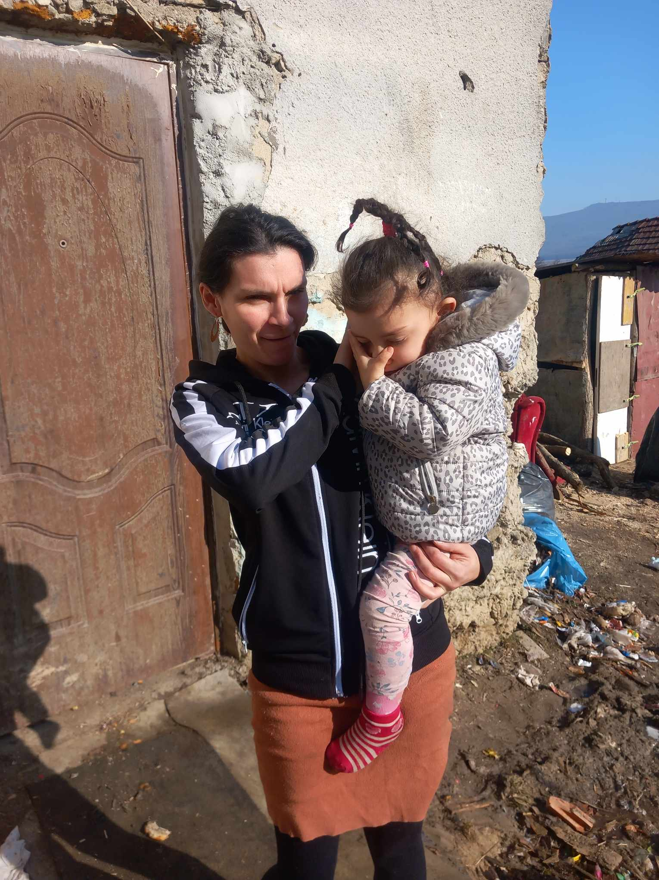
Best Practices and Working Methods
Individual approach to the child – setting and achieving individual goals based on the child's needs and capabilities.
Group activities – the child learns socially appropriate patterns of behaviour.
Work with the whole family/community = long-term results and sustainability.
Methods stimulating motivation and effective learning:
Music Therapy
Art Therapy
Role-Playing
Cooperation: MINEDU (Ministry of Education, Research, Development and Youth of the Slovak Republic), Košice Self-Governing Region, municipal governments, local helping professions (doctor, teacher, psychologist, special education teacher, etc.)
Project PROFI MAMY, project code 06R01-20-V01-00134 is financed by the European Union NextGenerationEU
www.planobnovy.sk www.minedu.sk www.sisa.home.sk

Slide 4
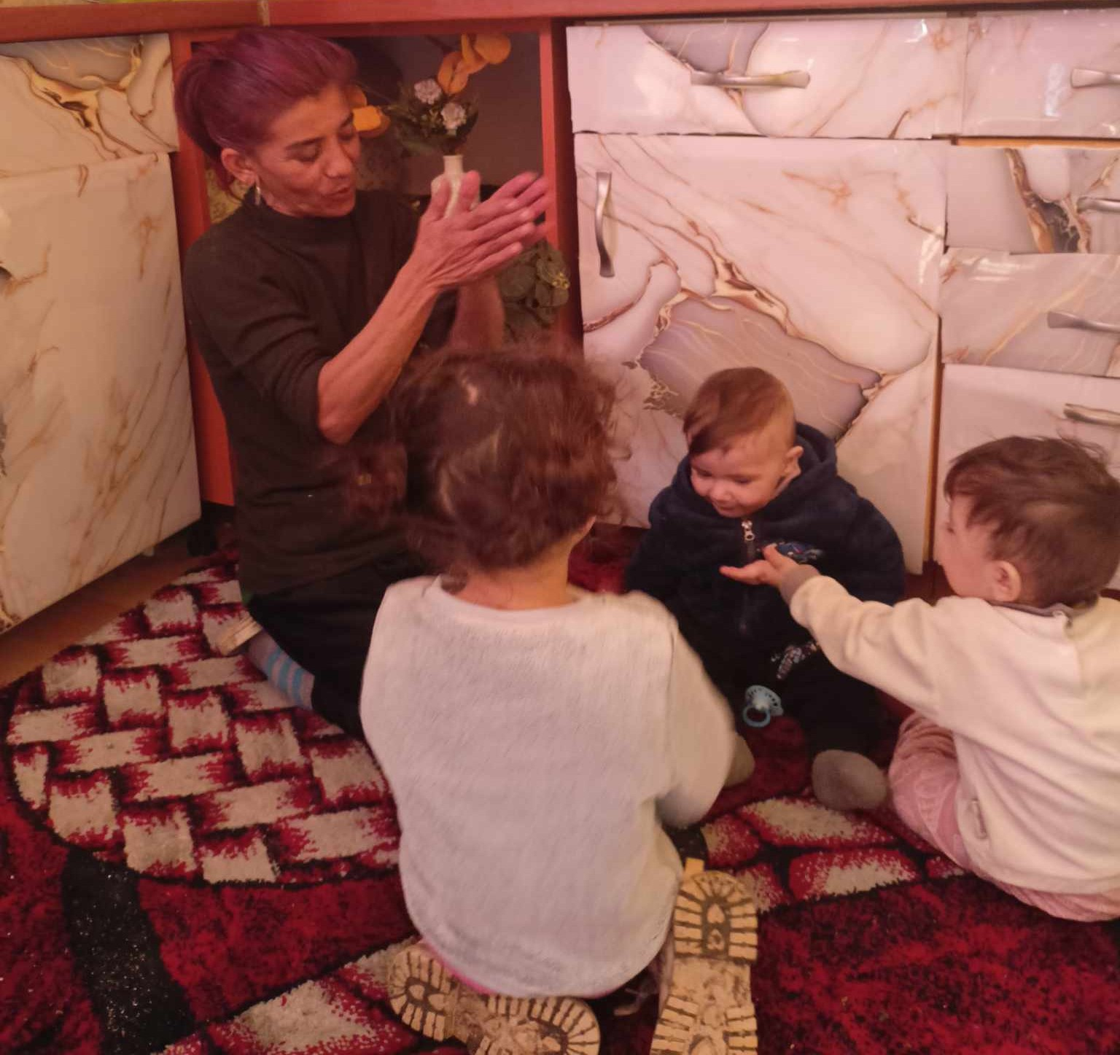
Outputs and Results
Children
Parents
Early Education Assistants
3 areas:
Language and knowledge
Social skills – behaviour, motivation, self-confidence, communication
Technical and IT skills (Children's motor skills)
BEFORE | NOW | THEN
↓ education level
↓ self-confidence
↓ social skills
Motivation to learn
Active engagement
Socially acceptable behaviour
↑ educational attainment
↑ competitiveness
↑ building social relationships with
the majority population
Project PROFI MAMY, project code 06R01-20-V01-00134 is financed by the European Union NextGenerationEU
www.planobnovy.sk www.minedu.sk www.sisa.home.sk

Slide 5
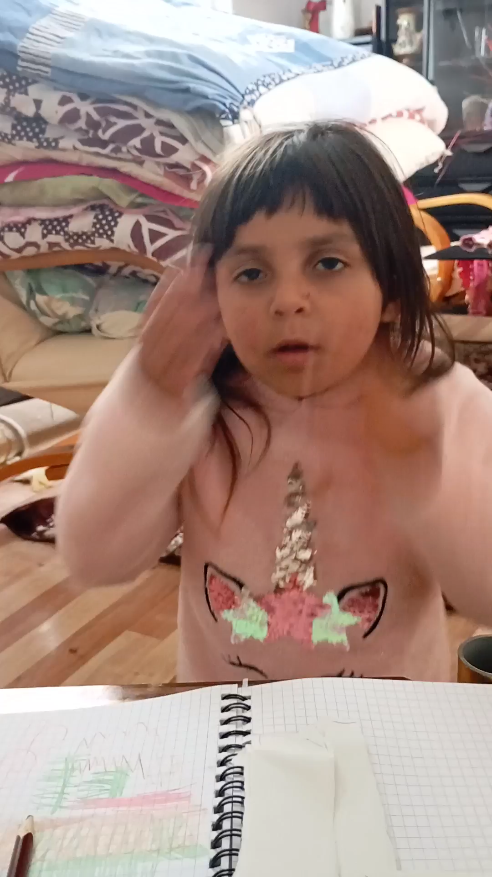
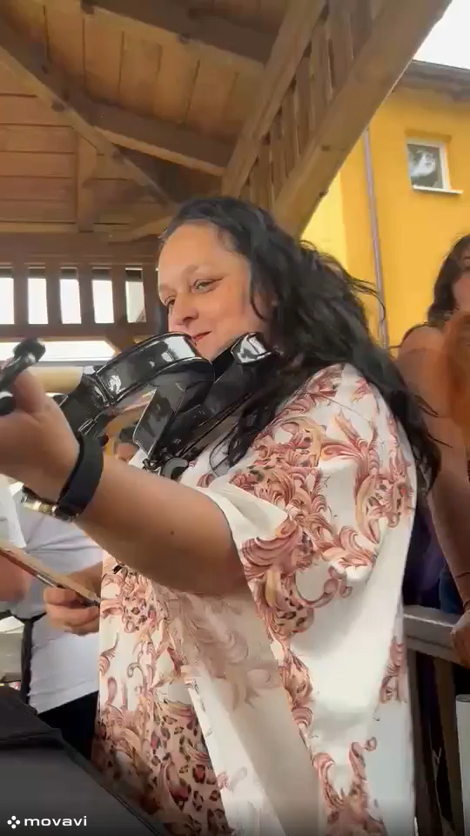
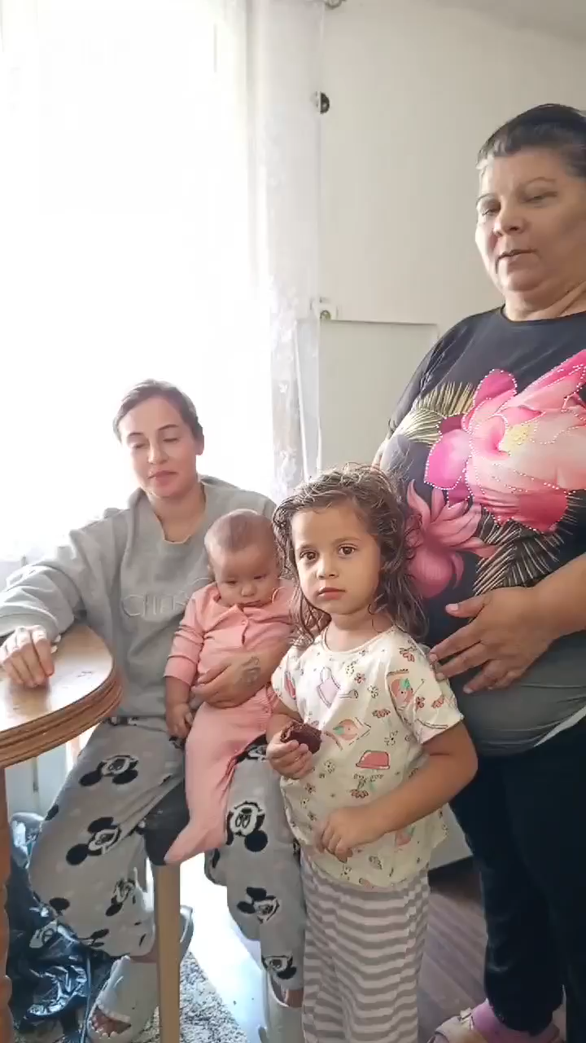
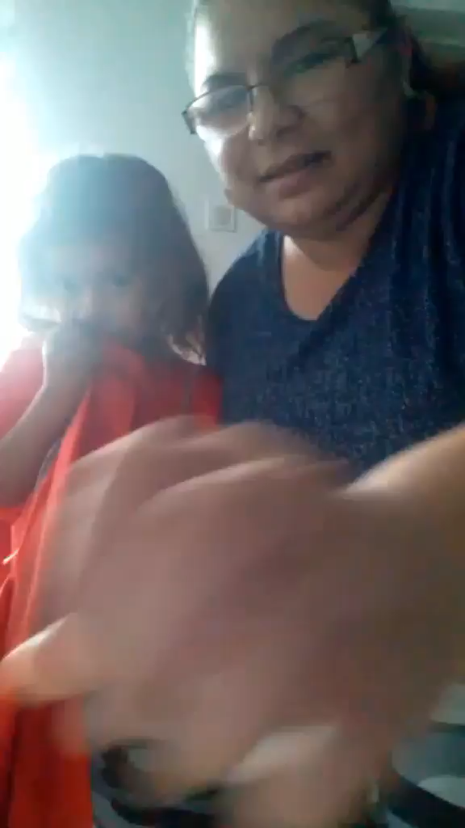
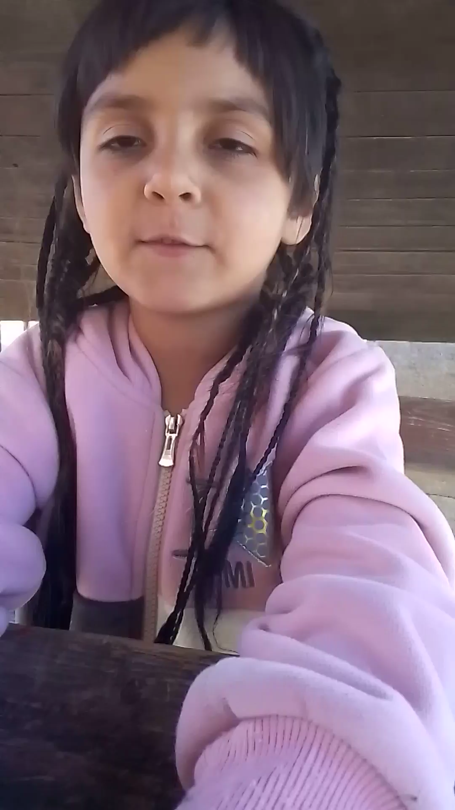
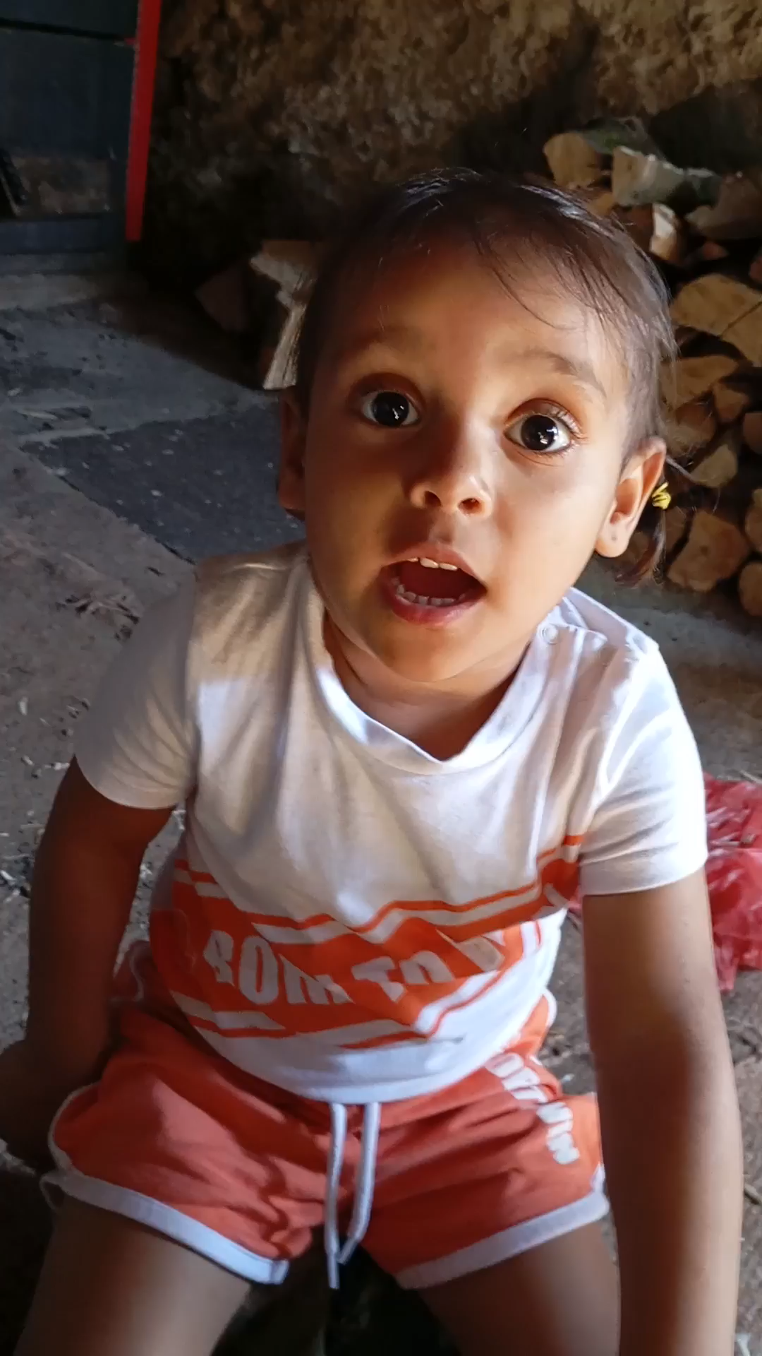
Photo and video presentation
Project PROFI MAMY, project code 06R01-20-V01-00134 is financed by the European Union NextGenerationEU
www.planobnovy.sk www.minedu.sk www.sisa.home.sk

